Slide 1
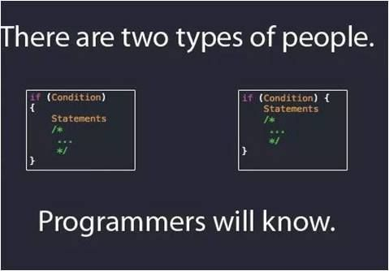
M02 L07 Decision Structures and Career Panel

Slide 2
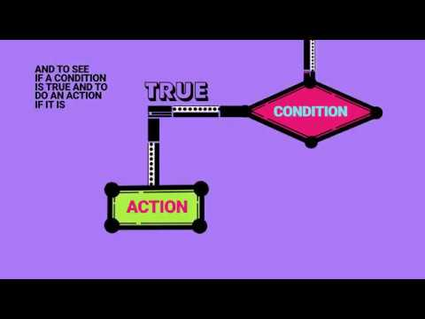
Today
Yes Silly Humor from Deb
GE 01 and Quiz Review
Importance of making a schedule to put 6 - 9 hours a week over 2 to 4 days each week to go over lectures and work on guided exploration.
Goals
To implement if/else selection controls
Boolean data type
Relational operators
If, if/else

Slide 3
Project Opportunity at MSU
Dates for the first Kubernetes MiniShop:
Tuesday March 4th, 2025 at 1:00 PM
Wednesday March 5th, 2025 at 2:00 PM
Thursday March 6th, 2025 at 10:00 AM
I have a booking link for students to sign-up on: https://outlook.office.com/book/MSUDenverTheCybersecurityCenterBookings@msudenver.onmicrosoft.com/?ae=true&login_hint
My spots are limited to 6 participants per workshop session due to hardware limitations.
From
Maciej Wal
Interim Assistant Director | Cybersecurity Platform Architect The Cybersecurity Center

Slide 4
Get Ready for Career Panel
Career Panel at 4:50 - Get paper out and put your first and last name on it. After the panel you will write down two things you learned and turn it in to me at the end of class.
Panelists for Wednesday, 2/12 at 4:50 PM MT - 5:50 PM MT
Joshua Lee – Software Engineer at CACI International (MSU Alum)
Jonathan Grant – Technical Support Engineer at Dynatrace (MSU Alum)
Julio Marquez - Manager, Customer Success (Customer Success Engineers/Technical Product Specialists) (MSU Alum)
Alison Ntwali – Software Engineer, Full Stack at CoBank
Panelists for Thursday 2/13 at 12 PM MT - 1 PM MT
Itzel Bailon (MSU Denver Alum) – Software Consultant at Dynatrace
Peter Walsh - Innovation Intern - Generative Artificial Intelligence at Jefferson County
Juan Elvir - Integration Support Engineer at Stream
Cherise Foster – Software Engineer at Home Depot

Slide 5
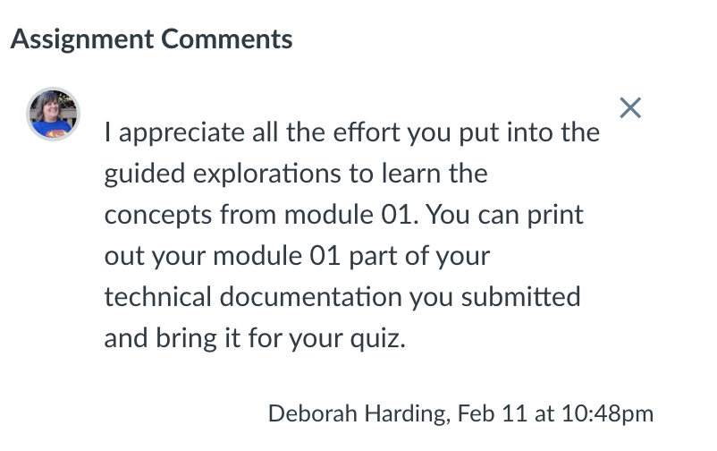
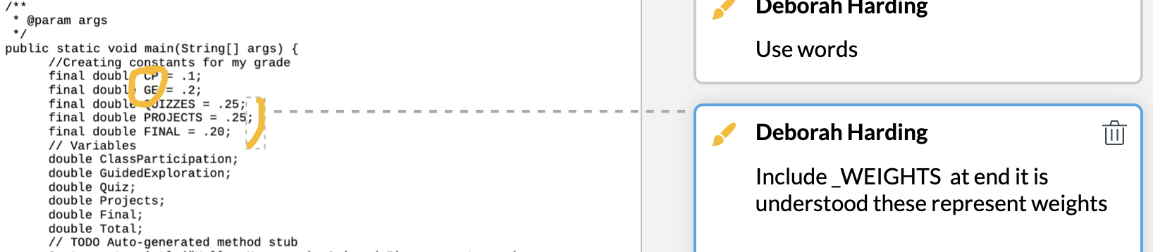
Open GE01
Look at comments on file and comments for overall assignment

Slide 6
Quiz and Technical Documentation
Open your GE01 to look at comments and feedback on your documents.
Prepare by: Reviewing Lecture for module 1, Retry Guided Exploration and create technical documentation
You can use your printed technical documentation from Module 1 guided exploration if it says you can in your GE01 comment feedback.
You do not need to print the set up environment part of the document. There will not be any questions about Eclipse, git or github.
You can bring what you submitted for the guided exploration.
Make sure you name is on your printed documentation as you will hand it in with your quiz.
If it is not the same as what you submitted for your guided exploration you will get a 0 on your quiz.
Content
40 Minutes and On paper
Questions: Multiple choice, true/false, matching
fill in the blank - for example evaluate an expression like the computer 4/5
Write code and explain code - for example write code to declare and initialize a variable and constant and explain what is happening in memory.

Slide 7
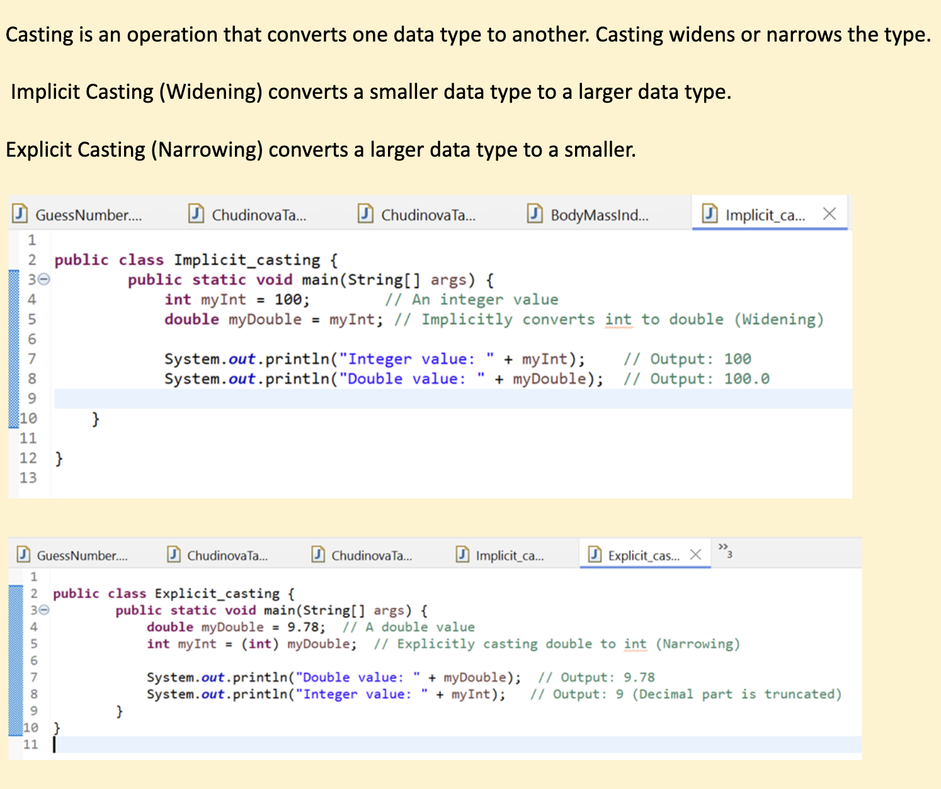
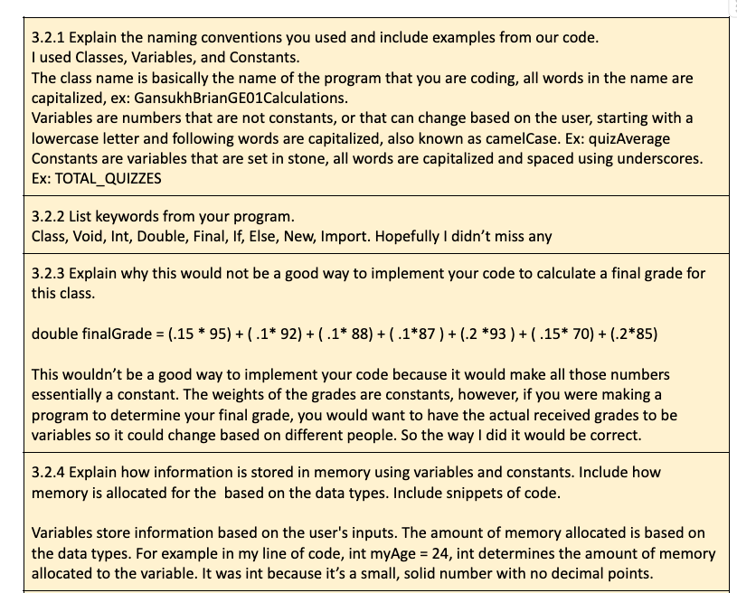
GE 01 Answers to Questions
Answering the guided exploration gives you information to put in your technical document
Brian G sec 003
GE01_CS1050_ChudinovaT sec 004

Slide 8
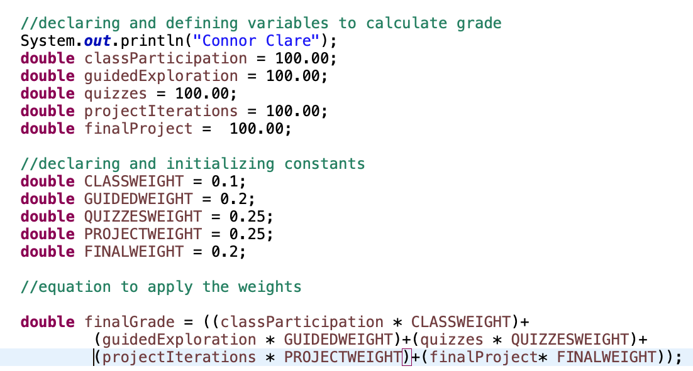
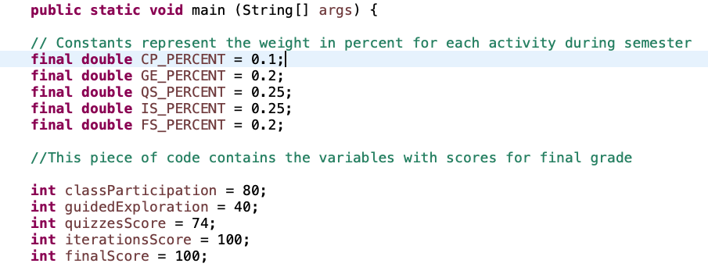
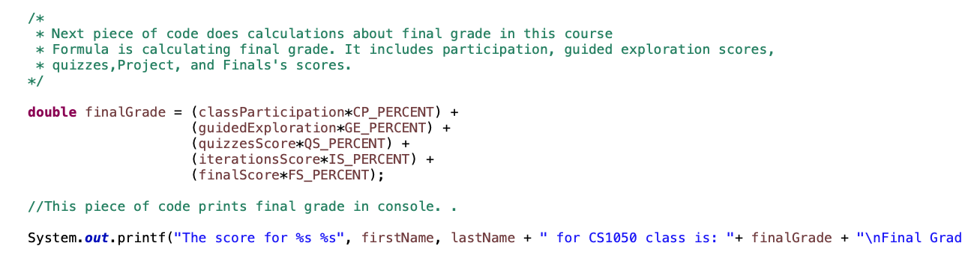
GE 01 Java Code Submission
Clare C sec 003
TatianaC sec 004

Slide 9
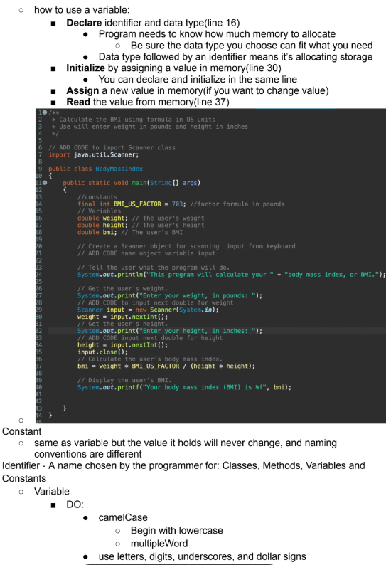
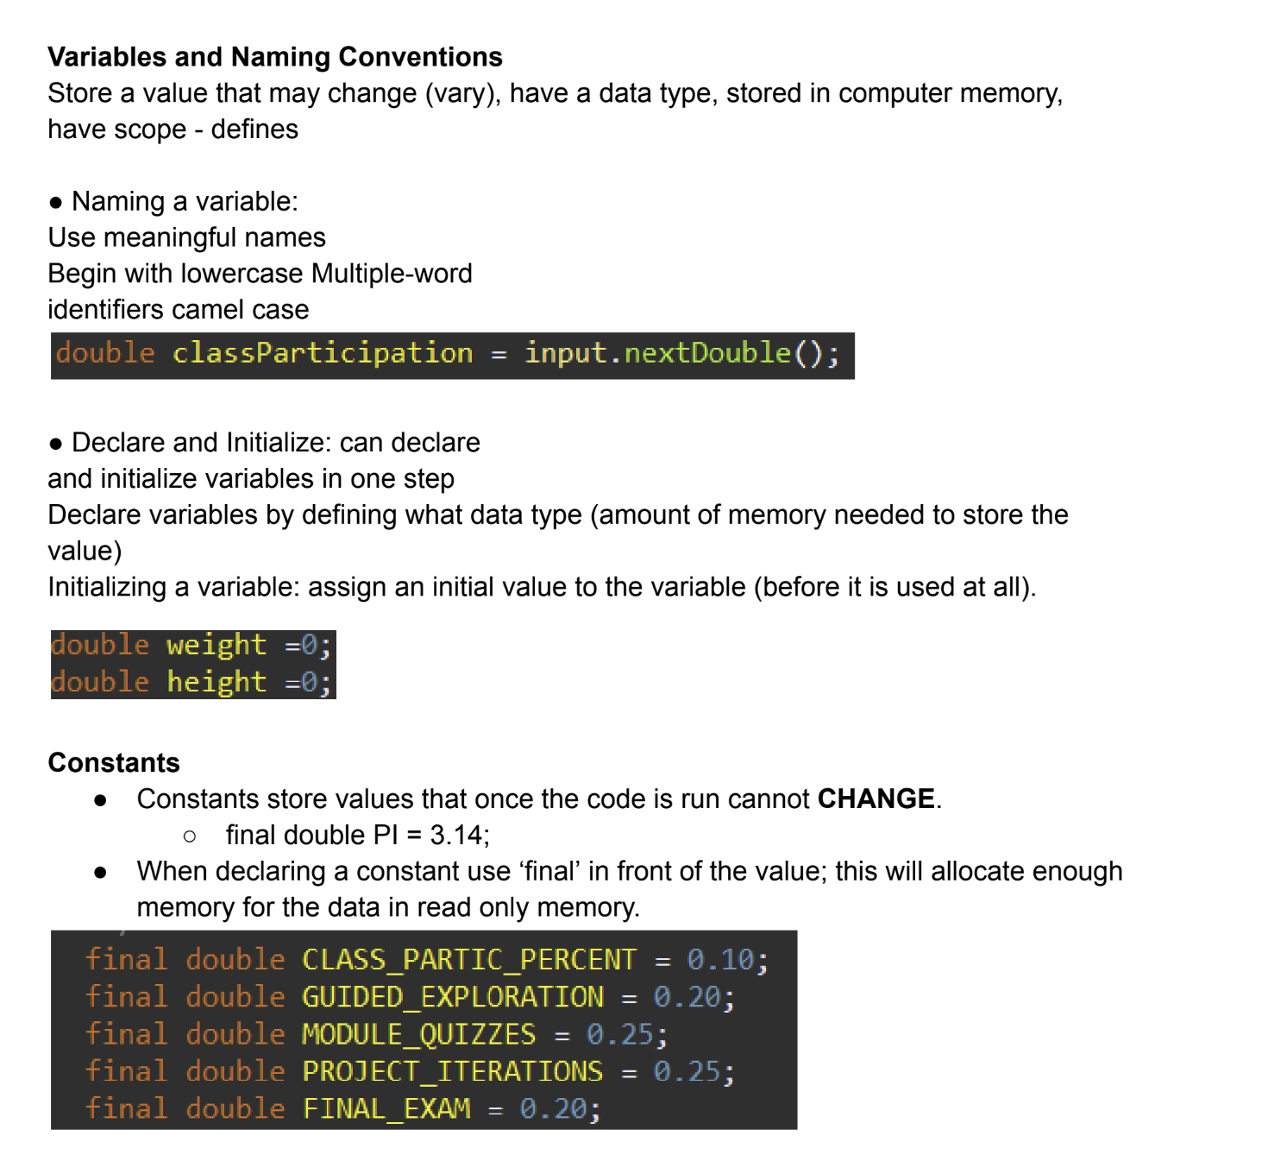
GE 01 Technical Document
Use guided exploration answers to create technical documentation
Sec 004 Jessica B
Sec 003 Elizabeth K

Slide 10
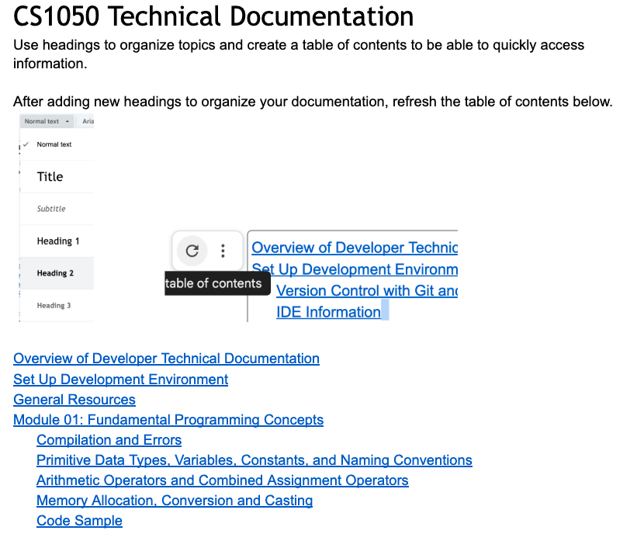
Tips For Completing Next GE
If you forgot to submit and they are versioned in your repository before the deadline come to office hours.
Deliverables: Upload each file separately and not as a zip file
Upload this document as a pdf or word document with your answers
Upload your .java file (not your class file)
Upload your technical documentation as a pdf or word document with your answers
2.1 Learning How to Learn
3.2 Create a Project and Program
Share tips

Slide 11
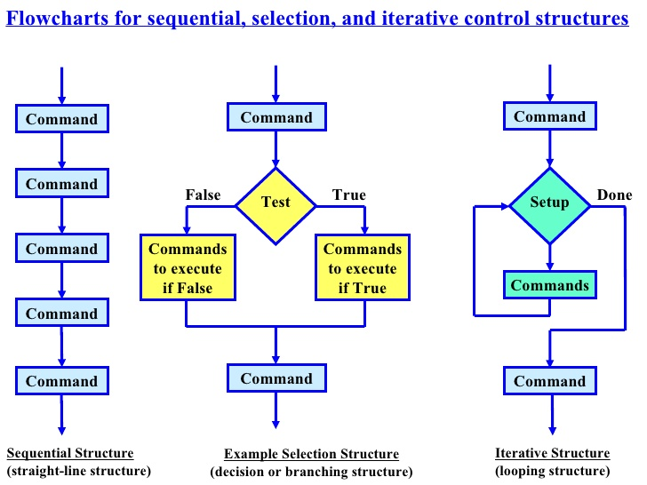
C o n t r o l
Flow of Control
The order in which statements are executed in a program
S​ t​ r​ u​ c​ t​ u​ r​ e​ s​

Slide 12
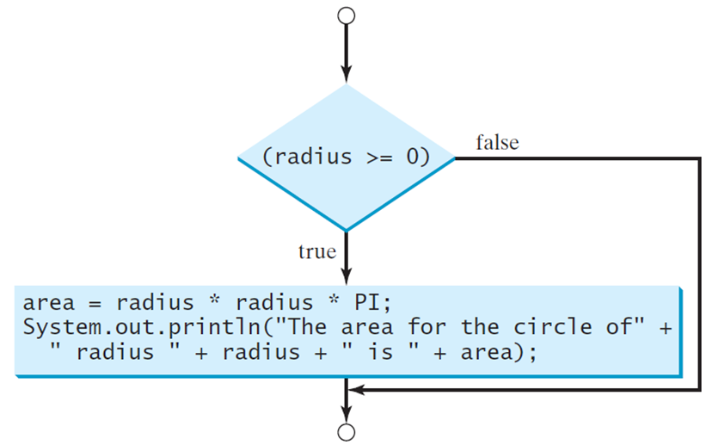
Making a decision based on whether true or false
If you enter a negative value for radius the program would print an invalid result when calculating the area of a circle. If the radius is negative, you don't want the program to compute the area. How can you deal with this situation?
Flowchart for decisions
Pseudocode for decisions
if radius >= 0
area = radius * radius * PI
print area of circle
end if
area = radius * radius * PI
print area of circle

Slide 13
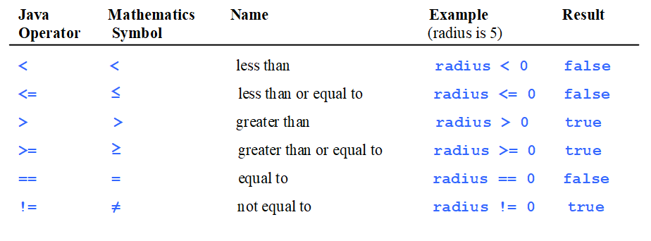
Relational Operators
Relational operators are used to compare values.
== is used to compare and = is used to assign a value to a memory location

Slide 14
Boolean Data Type
Very often, in programming, you will need a data type that can only have one of two values, like:
YES / NO
ON / OFF
TRUE / FALSE
This Boolean data type is used for simple flags that track true/false conditions.
Conditionals Allow different paths within code to be taken based on the outcome being true or false.
The if-else statement makes a decision based on if a condition is true
Provides ability to select a path of execution based on a condition
“If statements” implement conditional execution - alters flow of control
If it is snowing today, then I'm not going to class.

Slide 15
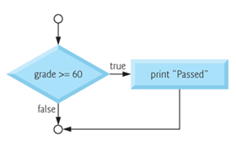
One Way Selection Structure: if
The if statement is called a single-selection statement because it selects or ignores a single action based on a Boolean (true or false) expression.
if (boolean expression)
{
statement(s); //Execute these statements if condition is true
}
Is either true or false
if (grade >= 60)
{
System.out.println ("Passed");
}

Slide 16
Lab Activity
Open ComputeAreaWithInput and run animation
Click ComputeAreaWithInput compile and run
Update FILL_CODE_OR_CLICK_ANSWER
Compile and Run Code
Add if condition to code to to only compute and display area if the radius is greater than 0.
Do not close you will add more code soon.

Slide 17
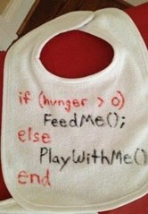
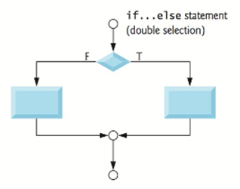
Two Way Selection Structure: if/else
The if…else statement is called a double-selection statement because it selects between two different actions.
if (boolean expression)
{
statements(s); // Execute these statements if condition is true
}
else
{
statement(s); // Execute these statements if condition is false
}
Is either true or false
Create readable code
Use indentation
use braces to start and close if and else code block
if (grade < 60)
{
System.out.println ("Come two office hours");
} else
{
System.out.println ("Passed");
}

Slide 18
Lab Activity
7. Add else branch to your if condition code to display the message “The radius must be greater than 0 to calculate the area” when they do not enter a positive value.

Slide 19
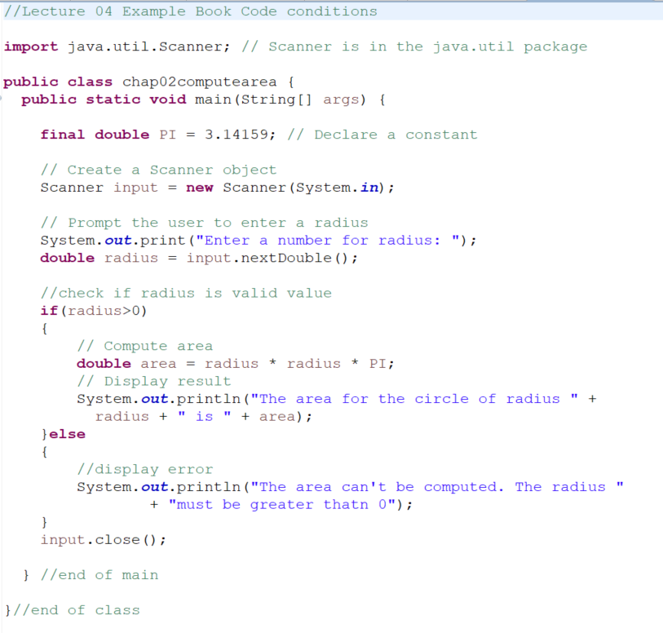

Slide 20
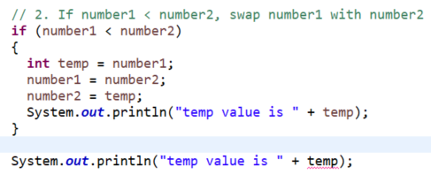
Explore
Open https://liveexample.pearsoncmg.com/liang/intro12e/html/SubtractionQuiz.html
Run animation for this code twice. Once with correct answer and once with incorrect answer
Open https://liveexample.pearsoncmg.com/liang/intro12e/html/SubtractionQuiz.html
Click compile/run button and update the three FILL_CODE_OR_CLICK_ANSWER
Compile and run updated code
Updated SubtractionQuiz to print temp value in if block inside { } and after if{ }
Start { and
end }
of if block
Print value of temp in if block
Print value of temp outside if block
Why is this an error? Look at where temp is declared.

Slide 21

Scope: if else block
Scope is the area of the program that the variable is available
Start { and
end }
of if block
Declared in scope of if block so can only be used between the if start { and end } braces
In scope of if block
Out of scope of if block

Slide 22
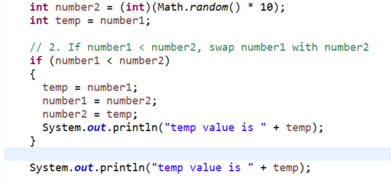
Explore
Add the following to your code
Move to declare temp before if block
Start { and
end }
of if block
Print value of temp inside if block
Print value of temp outside if block
Why is this not an error?

Slide 23
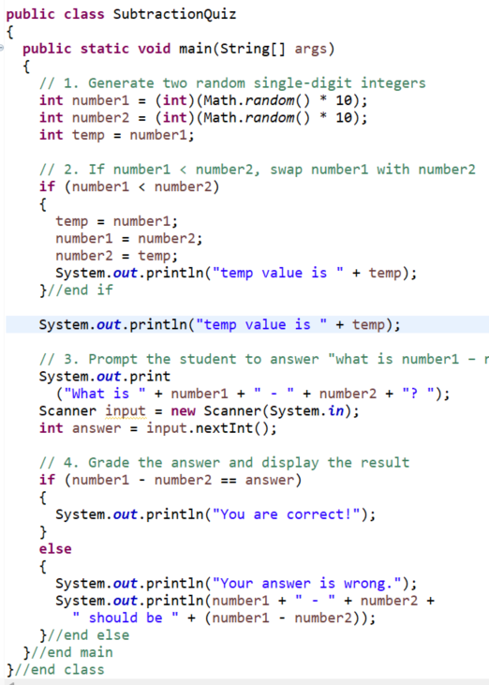
Scope
C
l
ass
Start of main
Declared temp within scope of main
m
a
i
n
m
e
t
h
o
d
i
f
Start of if
Now what is the scope of number1, number2, temp, input, answer?
End of if
What warning is shown in the code? How do you fix it?
i
f
else
End of main

Slide 24
Common Errors and Pitfalls
Logic errors
Error that causes your program to produce the wrong result.
If-statements are an area where logic errors are easy to create!
Forgetting Necessary Braces
Causes flow to be incorrect - leads to logical errors
Indentation does not dictate flow of control – it’s only for readability
Always include braces for this class
if (numStudents <= 30)
System.out.println ("Class is available");
else
System.out.println (“Class is not available”);
System.out.println (“You will be placed on the waitlist”);
if (numStudents <= 30)
{
System.out.println ("Class is available");
}
else
{
System.out.println (“Class is not available”);
System.out.println (“You will be placed on waitlist”);
}
Not part of else

Slide 25
Common Errors and Pitfalls
Wrong Placement of Semicolon
Causes flow of control to be incorrect - leads to logical error
DO NOT place a semicolon at the end of if (boolean expression) before curly brace
If you say if (boolean expression);
if (numStudents <= 30);
{
System.out.println ("Class is available");
}

Slide 26

Common Errors and Pitfalls
Using assignment = instead of equality ==
Common issue!
Compiler error – indicates there is a type mismatch - can't convert int to boolean
This is an assignment statement not a boolean expression
if (mathGrade = 90) {
{
//statements
}
Compiler will say it can't convert int to boolean because it is expecting a boolean expression (true or false) not an assignment statement
This means check if the amount the left is equal to the amount on the right. It returns true or false but doesn’t assign an value to a variable.
This means assign a new value to the variable

Slide 27
Preparation
Participation: Get paper out and put your first and last name on it. After the panel you will write down two things you learned and turn it in to me at the end of class.
Look at the preparation in canvas - prepare for quiz

